Slide 1

UNIVERSITY INSTITUTE OF ENGINEERING
COMPUTER SCIENCE ENGINEERING
Machine Learning
23CSH-651
By
Dr. Meena Pundir
INTRODUCTION
DISCOVER . LEARN . EMPOWER

Slide 2
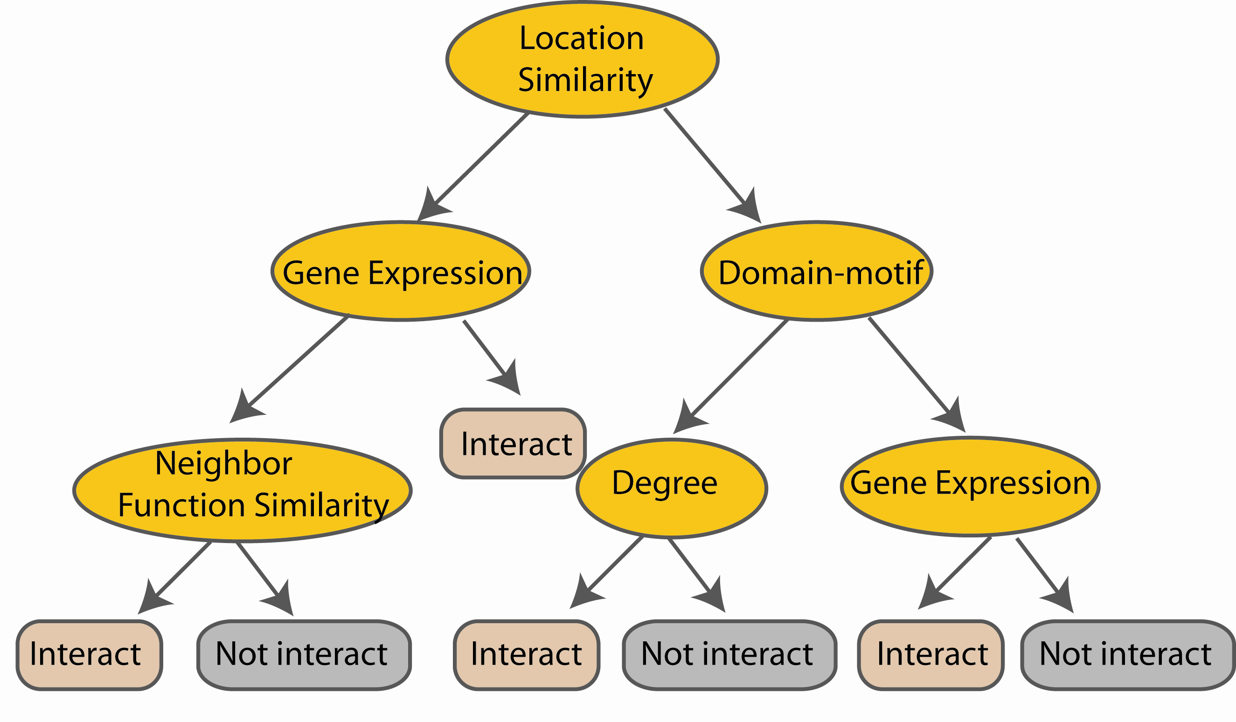
Random Forest Classifier
Construct a decision tree
M features
N examples
....…

Slide 3

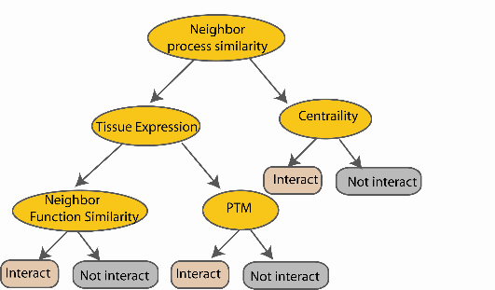
Random Forest Classifier
M features
N examples
Take the majority vote
....…
....…
Notes:
Finally the given an input data the decision is made as follows given an input data,

Slide 4
Random forest classifier
Random forest classifier, an extension to
bagging which uses de-correlated trees.

Slide 5
Random Forest Classifier
Training Data
M features
N examples
Notes:
As the classifier of choice we adopt Random Forest Classifier, due to its robustness to heterogenous and noisy feature.
Random Forest is an ensembe classifier. Briefly, given N data and M features, bootsrap samples are created from the traning data

Slide 6
Random Forest Classifier
Create bootstrap samples
from the training data
M features
N examples
....…

Slide 7
Random Forest Classifier
Construct a decision tree
M features
N examples
....…
Notes:
From eachd descision tree .. In spliting the nodes, the Gini Gain is employed

Slide 8

Random Forest Classifier
At each node in choosing the split feature
choose only among m<M features
M features
N examples
....…
Notes:
Different from the regular decision trees in random forest, when the splitting feature is chosen from only a subset of allf eatures.
The robostness of the classifier arises from
bootsraping of the training data and the random selection of features, the the random choose of features.

Slide 9
Random Forest Classifier
Create decision tree
from each bootstrap sample
M features
N examples
....…
....…

Slide 10
Random Forest Classifier
M features
N examples
Take he majority vote
....…
....…
Notes:
Finally the given an input data the decision is made as follows given an input data,

Slide 11
